Slide 1

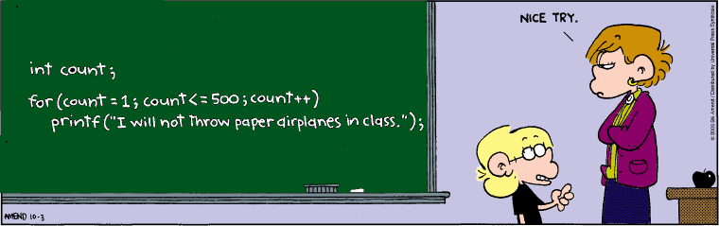
Programming
Programming concepts:
Loops

Slide 2
Last Week
Simple graphics commands:
Ellipse, point, line, size, stroke, fill, background
Variables – int & float
Arithmetic operators and expressions

Slide 3

Revision exercise
int x=50;
int y=50;
int radius = 30;
fill(255);
ellipse(x,y,radius*2,radius*2);
fill(0);
line(x-(radius/2),y,x,y);
line(x,y-(radius*4/5),x,y);
int x=50;
int y=50;
fill(255);
ellipse(x,y,60,60);
fill(0);
line(x-15,y,x,y);
line(x,y-24,x,y);
How would we make our shape bigger/smaller ?
Use another variable?

Slide 4
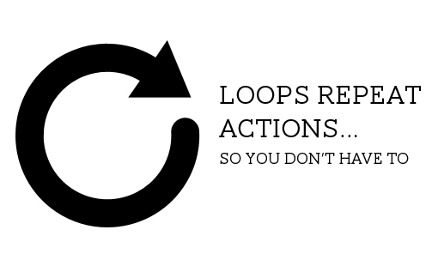
Learning Objectives
Repetition of commands
For Loop – determinate Loop
Repeats a set of commands a specific number of times
Boolean test (expression) – true/false
Pseudocode – problem step written in English
Help to design/write code
Solve problems
While loop – Indeterminate Loop
Repeats while a test is true
We’ll use while a lot
later in the course

Slide 5
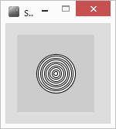
Example
Want to draw concentric circles
int size=50;
for(int i=0; i<10; i++)
{
ellipse(50,50,size,size);
size=size-5;
}
Note : for loop has no ; uses the braces { }
commands inside are repeated

Slide 6
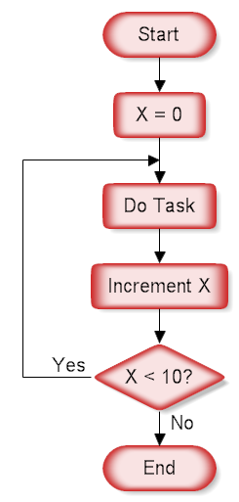
For Loop : syntax
for( int i=0 ; i<10 ; i++ )
Always use a variable – typically a counter i
For – 3 parts, divided by ‘;’
int i = 0 variable starting value(s)
i is a counter with an initial value of 0
i<10 end condition – keep going while true
If value in i is less than 10 keep going
i++ Do this each time around the loop
Add 1 to value in i (increment)
could also be written i=i+1

Slide 7
Example 1st Loop
i=i+1
size=size-5
drawing concentric circles
int size=50;
for(int i=0; i<10; i++)
{
ellipse(50,50,size,size);
size=size-5;
}
0
50
1
45
i
size

Slide 8
Example 2nd Loop
i=i+1
size=size-5
drawing concentric circles
int size=50;
for(int i=0; i<10; i++)
{
ellipse(50,50,size,size);
size=size-5;
}
2
1
45
40
i
size

Slide 9
Example 3rd Loop
i=i+1
size=size-5
drawing concentric circles
int size=50;
for(int i=0; i<10; i++)
{
ellipse(50,50,size,size);
size=size-5;
}
3
2
40
35
i
size

Slide 10
Example 10th Loop
i=i+1
size=size-5
drawing concentric circles
int size=50;
for(int i=0; i<10; i++)
{
ellipse(50,50,size,size);
size=size-5;
}
//finished loop
10
9
5
0
i
size
i is no longer < 10, loop complete

Slide 11
Another example
int size;
for(size=50; size>0; size=size-5)
{
ellipse(50,50,size,size);
}
What would this do?
Same result,
size is our counter- start value is 50
keep going while size bigger than 0
Each time take 5 away from size

Slide 12
For Loops – how many loops?
for(int i=1;i<=5;i++) //smaller than or equal to
{
//do task
}
for(int x=10;x<50;x=x+10)
{
//do task
}
for(int c=10;c>5;c--)
{
//do task
}
5 times i=1,2,3,4,5
ends when i=6
4 times x=10,20,30,40
ends when x=50
5 times c=10,9,8,7,6
ends when c=5

Slide 13
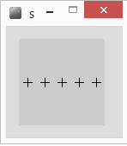
Draw 5 crosses
float x=10;
float y=50;
line(x-5,y,x+5,y);
line(x,y-5,x,y+5);
Draws a cross
centre at x,y
float x=10;
float y=50;
for(int i=0;i<5;i++)
{
line(x-5,y,x+5,y); // Draw cross
line(x,y-5,x,y+5);
x=x+20; //move right a bit
}
PseudoCode - English
For 5 repetitions
{
Draw a cross
Move right a bit
}

Slide 14
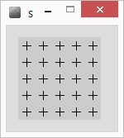
Nested For Loop
You can put one loop inside another
Here I want to draw 5 lines of crosses
Increasing y after each line
A for loop
Each line of crosses consists of 5 crosses
Another for loop
For 5 repetitions
{
For 5 repetitions
{
Draw a cross
Move right a bit
}
Move down a bit
}
PseudoCode - English
For 5 repetitions
{
Draw a line of crosses
Move down a bit
}

Slide 15
Nested For Loop 2
For 5 repetitions
{
For 5 repetitions
{
Draw a cross
Move right a bit
}
Move down a bit
}
float x=10;
float y=10;
for (int i=0;i<5;i++)
{
for(int j=0;j<5;j++)
{
line(x-5,y,x+5,y); //draw cross
line(x,y-5,x,y+5);
x=x+20; //move right a bit
}
x=10; //set x back to far left
y=y+20; //move down a bit
}
For loops : must be different
counter variables

Slide 16
Tracing Nested For Loops
float x=10;
float y=10;
for (int i=0;i<5;i++)
{
for(int j=0;j<5;j++)
{
line(x-5,y,x+5,y); //draw cross
line(x,y-5,x,y+5);
x=x+20; //move right a bit
}
x=10; //set x back to far left
y=y+20; //move down a bit
}
0
i
3
1
4
2
3
1
4
2
0
j

Slide 17
Tracing Nested For Loops
float x=10;
float y=10;
for (int i=0;i<5;i++)
{
for(int j=0;j<5;j++)
{
line(x-5,y,x+5,y); //draw cross
line(x,y-5,x,y+5);
x=x+20; //move right a bit
}
x=10; //set x back to far left
y=y+20; //move down a bit
}
1
i
3
1
4
2
3
1
4
2
0
j

Slide 18
Tidy up - Refactor
Refactor – tidy up the code
Use x and y as counters within for loops
for (int y=10; y<100; y=y+20)
{
for(int x=10; x<100; x=x+20)
{
line(x-5, y, x+5, y); //draw cross
line(x,y-5,x,y+5);
}
}
same result, fewer variables,
easier to understand the code

Slide 19
For Loop : Run time errors
Infinite loop – goes forever
Why?
for(int i=0; i>=0; i++)
i is ALWAYS 0 or greater
for(int i=0; i != 10; i=i+3) //i not equal to 10
i NEVER contains a 10
for(int i=0; i < 10; i++);
{ point( x+(i*10), 50); }
how many points?

Slide 20
While Loops
Very similar to for loop
int i=5;
while(i !=10 )
{
//do task
}
If test expression isn’t true, skips straight to end
Otherwise repeats tasks while expression is true

Slide 21
While vs For
Use For loop when you know how many times you want to perform a task
Use while loop when you don’t know how many repetitions
While something is true
Example want to draw crosses all across the screen (width is 100)
while (crossX < 100)
{
//draw cross at crossX
// move right a bit
}

Slide 22
Summary
For Loop – repeat task(s) a set number of times
Uses a counter variable (normally)
While loops – repeat while something is true (unknown number of repetitions
Pseudocode – problem decomposition
English statement of tasks
Boolean expressions (tests – for, while loops) true or false
e.g. i<10 i!=10 i==10 i>=10

